Slide 1

7th Grade Math
Unit 10, Lesson 3 Exploring Inequalities – Part 2 Volume 2, pg. 98

Slide 2


Benchmark
MA.7.AR.2.1
Write and solve one-step inequalities in one variable within a mathematical context and represent solutions algebraically or graphically.
volume 2, pg. 98

Slide 3
Integrated Mathematical Thinking and Reasoning Standards
MA.K12.MTR.1.1 Actively participate in effortful learning both individually and collectively.
MA.K12.MTR.2.1 Demonstrate understanding by representing problems in multiple ways.
MA.K12.MTR.4.1 Engage in discussions that reflect on the mathematical thinking of self and others.
MA.K12.MTR.6.1 Assess the reasonableness of solutions.
MA.K12.MTR.7.1 Apply mathematics to real-world contexts.
volume 2, pg. 98

Slide 4

Learning Targets
I can determine the minimum or maximum value that makes an inequality true.
I can relate the solution set of an inequality to the context it represents.
I can explore the relationship between the coefficients of the terms in an inequality and solution set.
volume 2, pg. 98

Slide 5

Warm-Up
volume 2, pg. 98

Slide 6
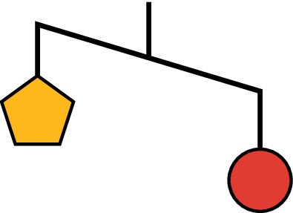
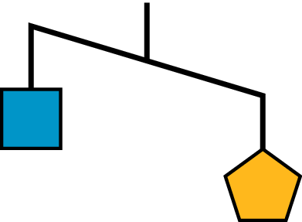
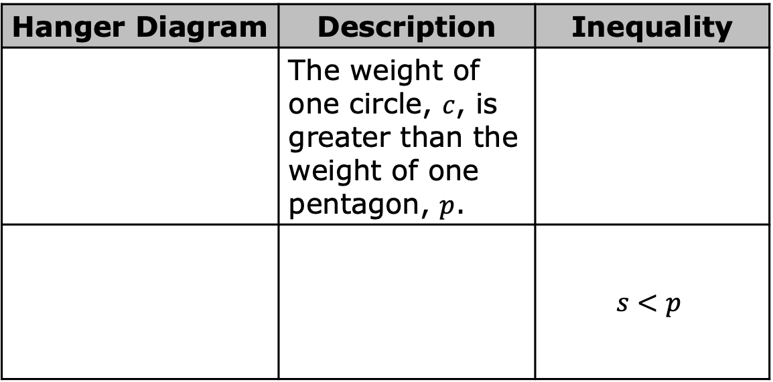
10.3.1 Warm-Up: Visual Models
An unbalanced hanger diagram is shown.
It shows that the weight of one circle is greater than the weight of one pentagon.
Complete the table.
Hanger Diagram | Description | Inequality
 | The weight of one circle, $c$, is greater than the weight of one pentagon, $p$.
 |  | $$s<p$$
volume 2, pg. 98

Slide 7
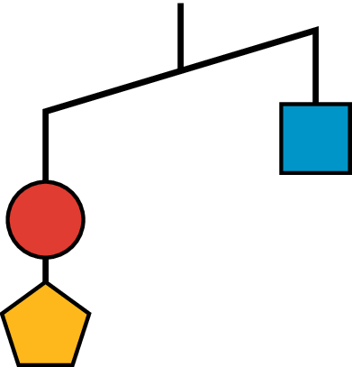
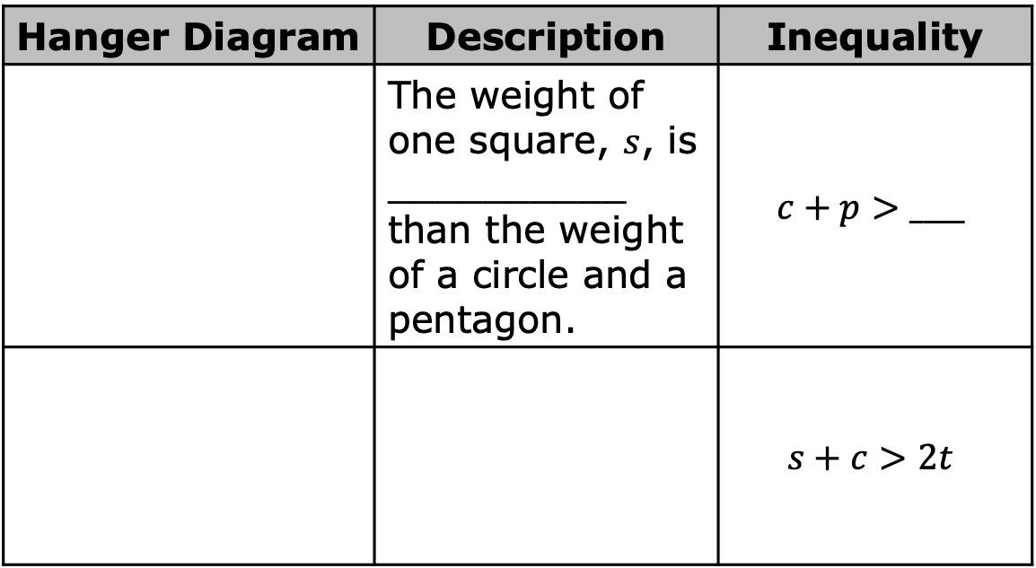
Hanger Diagram | Description | Inequality
 | The weight of one square, $s$, is __________ than the weight of a circle and a pentagon. | $$c+p>____$$
 |  | $$s+c>2t$$
volume 2, pg. 98

Slide 8

Exploration
volume 2, pg. 99

Slide 9

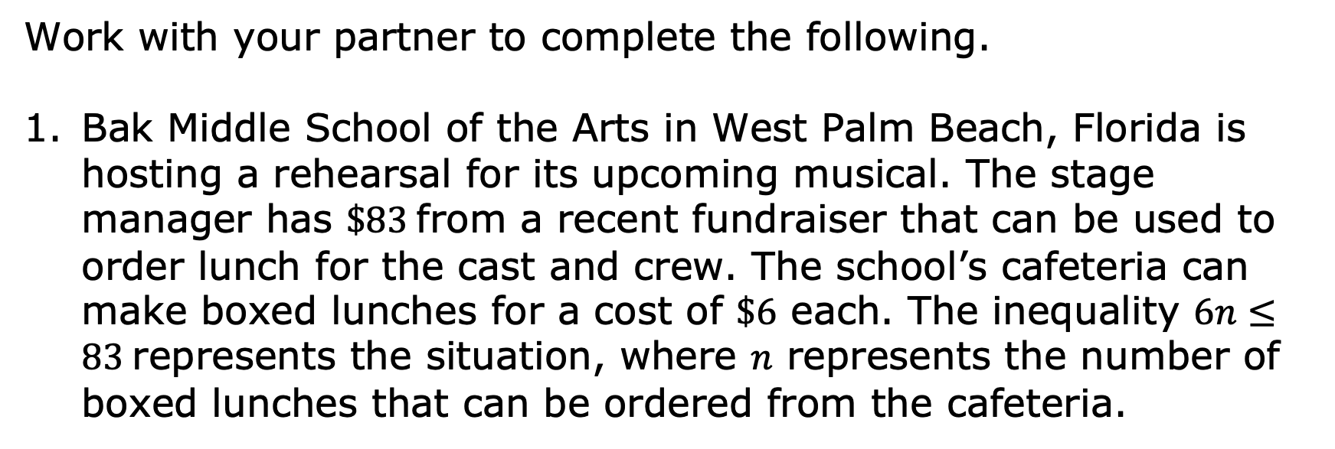
10.3.2 Exploration: Determining the Minimum or Maximum Value that Makes an Inequality True
Work with your partner to complete the following.
Bak Middle School of the Arts in West Palm Beach, Florida is hosting a rehearsal for its upcoming musical. The stage manager has $\$83$ from a recent fundraiser that can be used to order lunch for the cast and crew. The school’s cafeteria can make boxed lunches for a cost of $\$6$ each. The inequality $6n≤83$ represents the situation, where $n$ represents the number of boxed lunches that can be ordered from the cafeteria.
volume 2, pg. 99

Slide 10
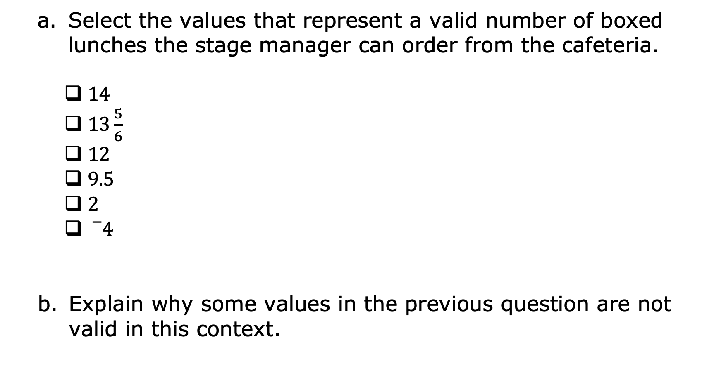
Select the values that represent a valid number of boxed lunches the stage manager can order from the cafeteria.
$14$
$13\frac{5}{6}$
$12$
$9.5$
$2$
${}_{}^{−}4$
Explain why some values in the previous question are not valid in this context.
volume 2, pg. 99

Slide 11
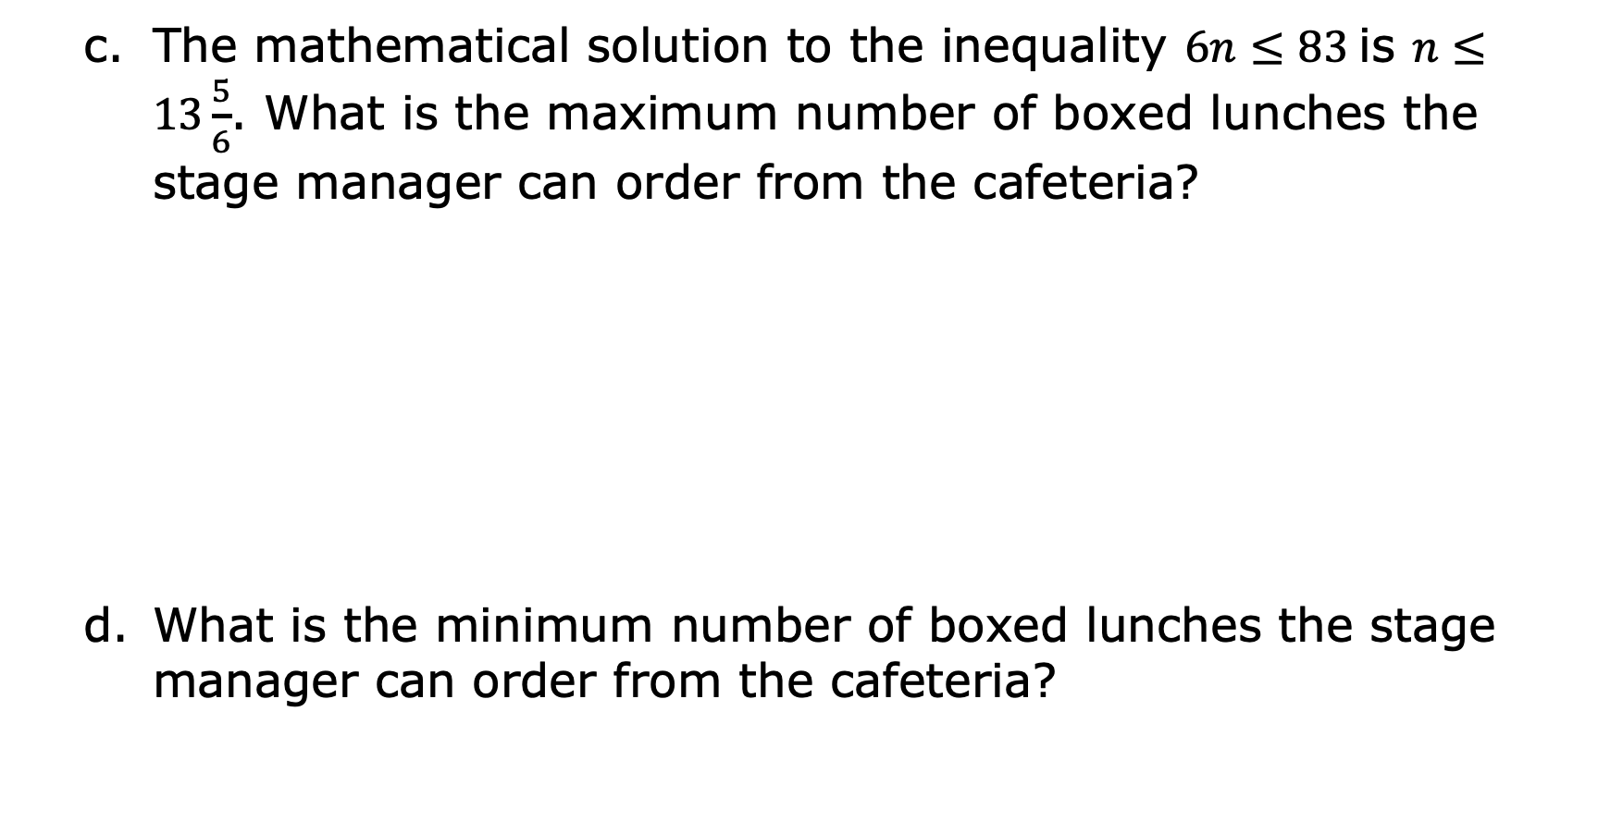
The mathematical solution to the inequality $6n≤83$ is $n≤13\frac{5}{6}$. What is the maximum number of boxed lunches the stage manager can order from the cafeteria?
What is the minimum number of boxed lunches the stage manager can order from the cafeteria?
volume 2, pg. 99

Slide 12
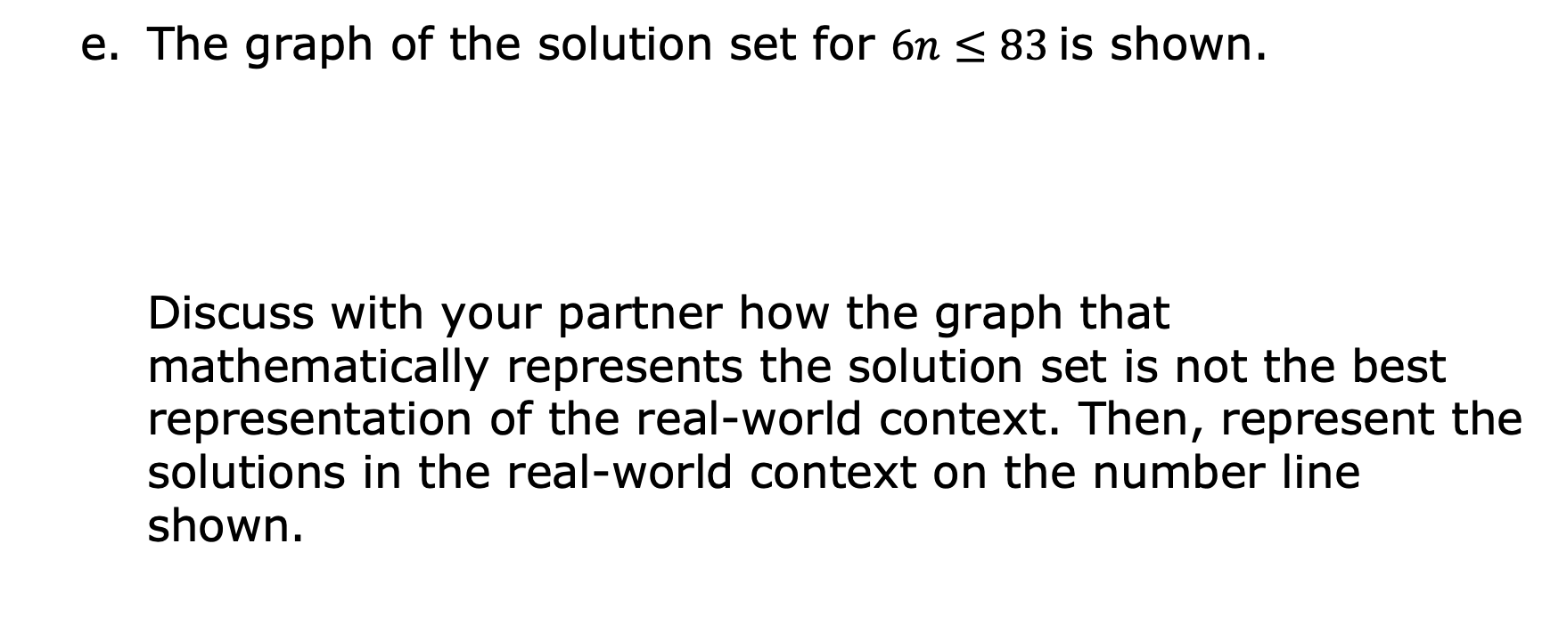
The graph of the solution set for $6n≤83$ is shown.
Discuss with your partner how the graph that mathematically represents the solution set is not the best representation of the real-world context. Then, represent the solutions in the real-world context on the number line shown.
volume 2, pg. 100

Slide 13
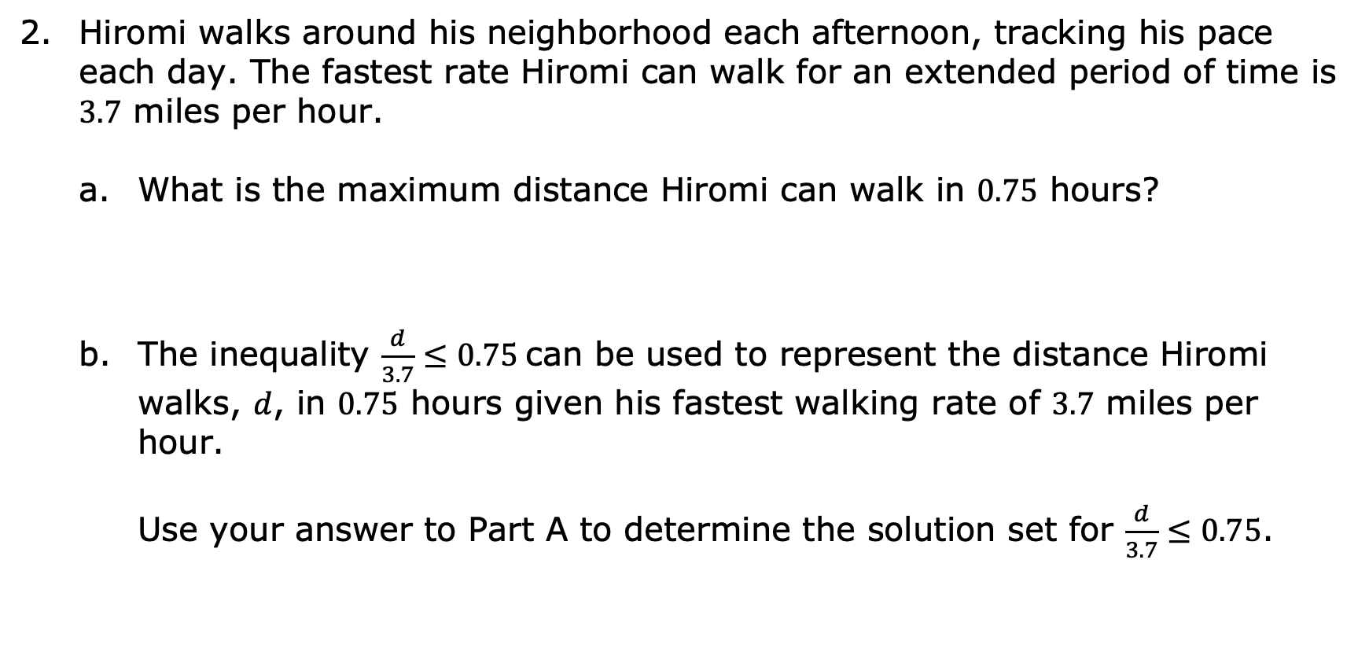
Hiromi walks around his neighborhood each afternoon, tracking his pace each day. The fastest rate Hiromi can walk for an extended period of time is $3.7$ miles per hour.
What is the maximum distance Hiromi can walk in $0.75$ hours?
The inequality $\frac{d}{3.7}≤0.75$ can be used to represent the distance Hiromi walks, $d$, in $0.75$ hours given his fastest walking rate of $3.7$ miles per hour.
Use your answer to Part A to determine the solution set for $\frac{d}{3.7}≤0.75$.
volume 2, pg. 100

Slide 14

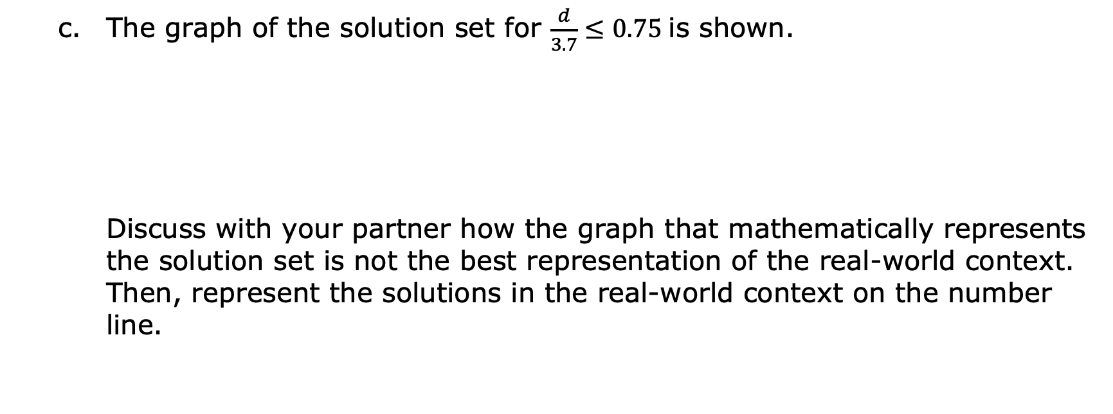
The graph of the solution set for $\frac{d}{3.7}≤0.75$ is shown.
Discuss with your partner how the graph that mathematically represents the solution set is not the best representation of the real-world context. Then, represent the solutions in the real-world context on the number line.
volume 2, pg. 100

Slide 15

Bring It Together
volume 2, pg. 101

Slide 16


10.3.3 Bring It Together: Solutions and Mathematical Models in Context
Each of the inequalities in the Exploration has a mathematical solution set that can be represented on a number line. These graphs are examples of mathematical models.
Mathematical models are helpful tools used to understand a situation and make predictions. However, sometimes the mathematical model can include parts that do not make sense in a real-world context. When interpreting models to solve problems, it is important to analyze whether aspects of the model make sense in a given context.
volume 2, pg. 101

Slide 17
Exploration
volume 2, pg. 101

Slide 18
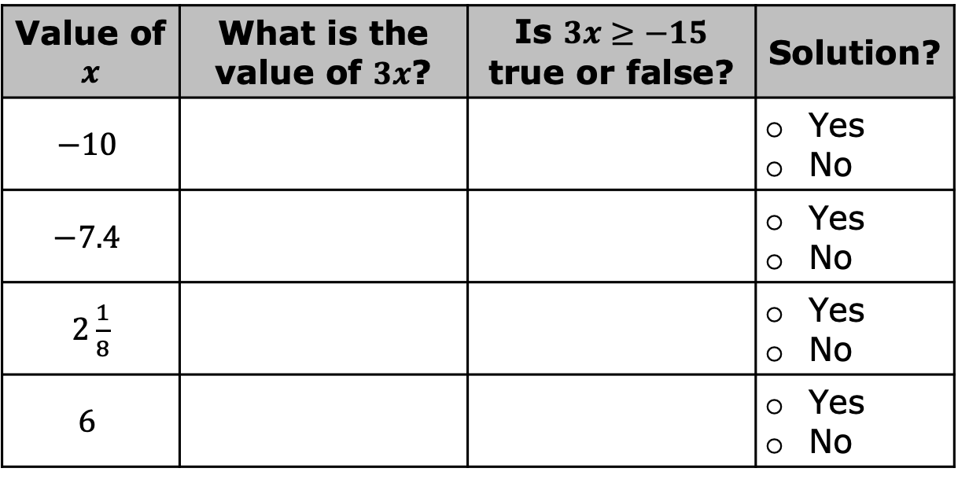
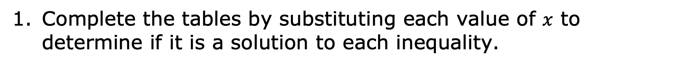
10.3.4 Exploration: Matching Inequalities to Solutions
Complete the tables by substituting each value of $x$ to determine if it is a solution to each inequality.
Value of $x$ | What is the value of $3x$? | Is $3x≥−15$ true or false? | Solution?
$$−10$$ |  |  | Yes No
$$−7.4$$ |  |  | Yes No
$2\frac{1}{8}$ |  |  | Yes No
$$6$$ |  |  | Yes No
volume 2, pg. 101

Slide 19
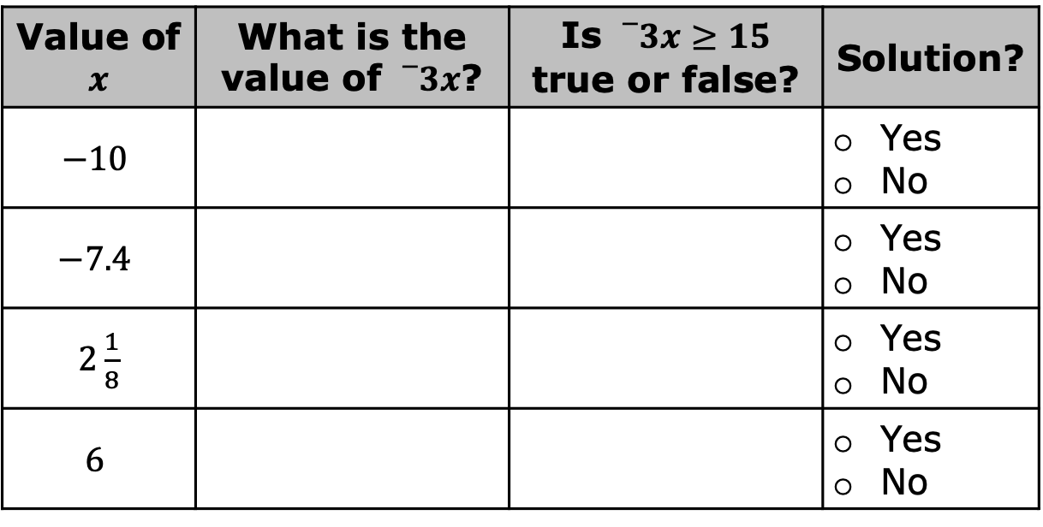
Value of $x$ | What is the value of ${}_{}^{−}{3x}$? | Is ${}_{}^{−}{3x}≥15$ true or false? | Solution?
$$−10$$ |  |  | Yes No
$$−7.4$$ |  |  | Yes No
$2\frac{1}{8}$ |  |  | Yes No
$$6$$ |  |  | Yes No
volume 2, pg. 101

Slide 20
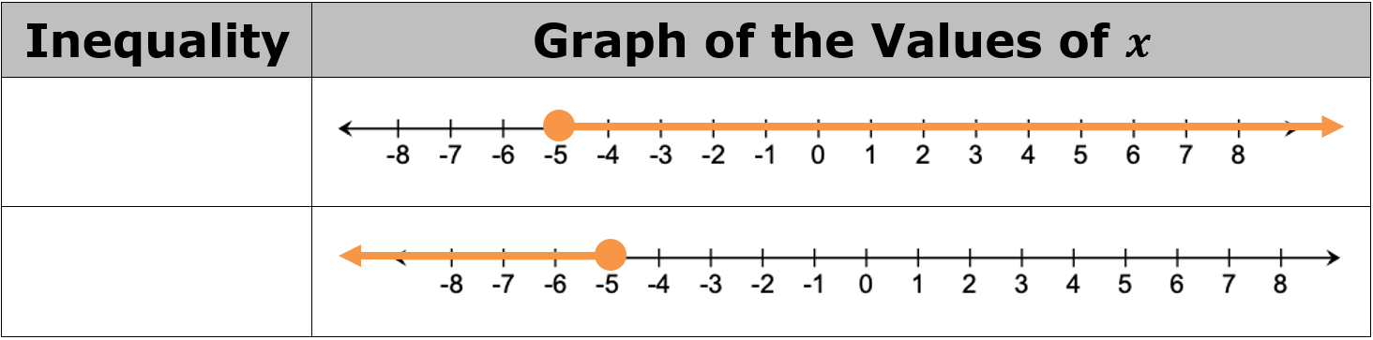
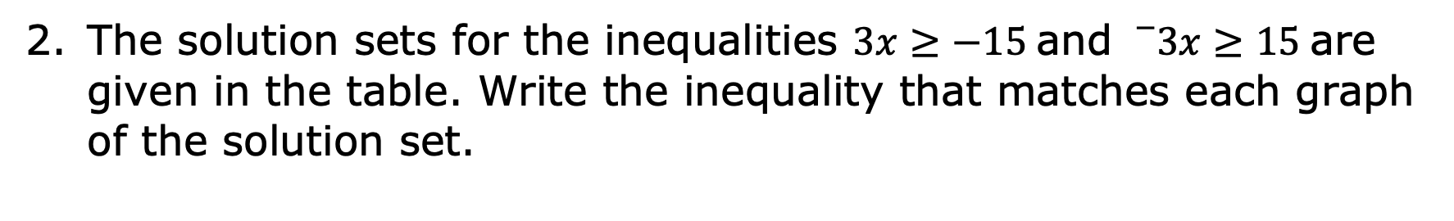
The solution sets for the inequalities $3x≥−15$ and ${}_{}^{−}{3x}≥15$ are given in the table. Write the inequality that matches each graph of the solution set.
volume 2, pg. 102

Slide 21
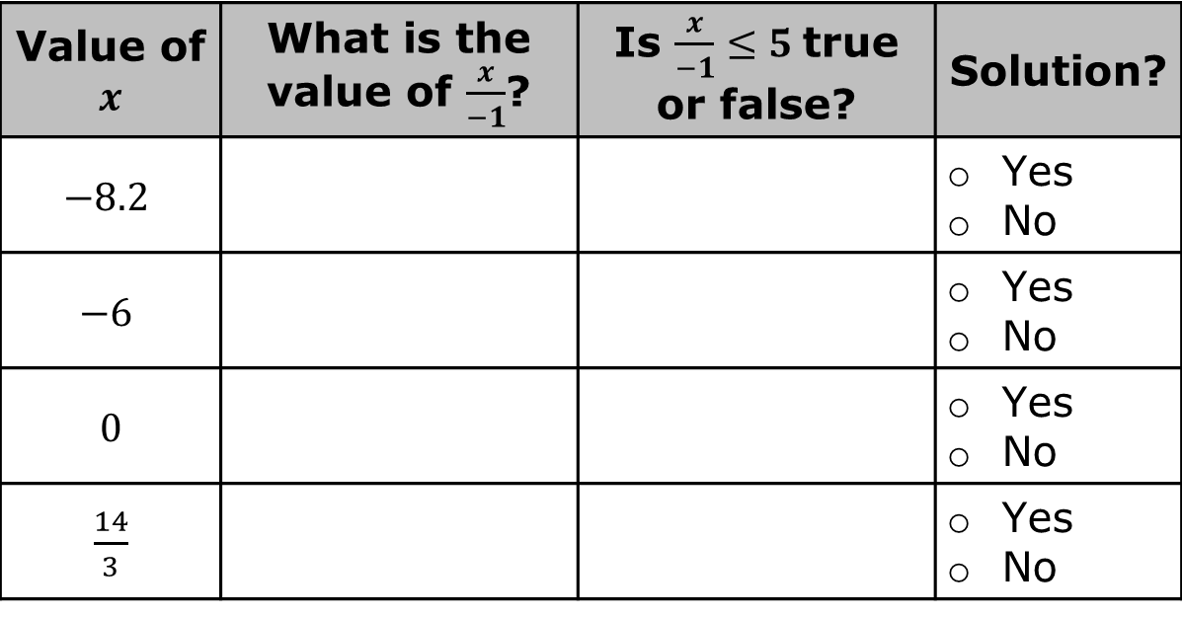
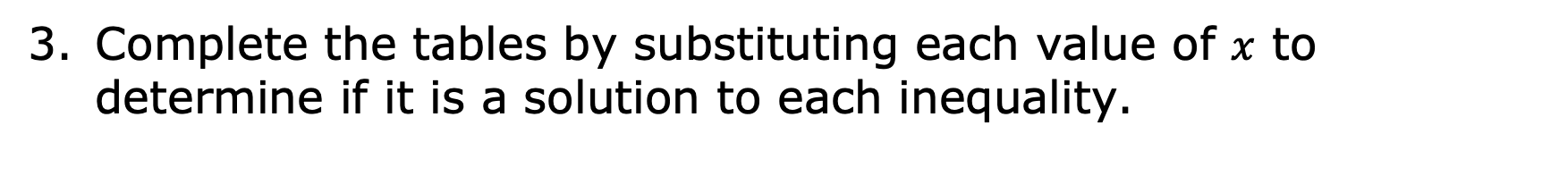
Complete the tables by substituting each value of $x$ to determine if it is a solution to each inequality.
Value of $x$ | What is the value of $\frac{x}{−1}$? | Is $\frac{x}{−1}≤5$ true or false? | Solution?
$$−8.2$$ |  |  | Yes No
$$−6$$ |  |  | Yes No
$0$ |  |  | Yes No
$\frac{14}{3}$ |  |  | Yes No
volume 2, pg. 102

Slide 22
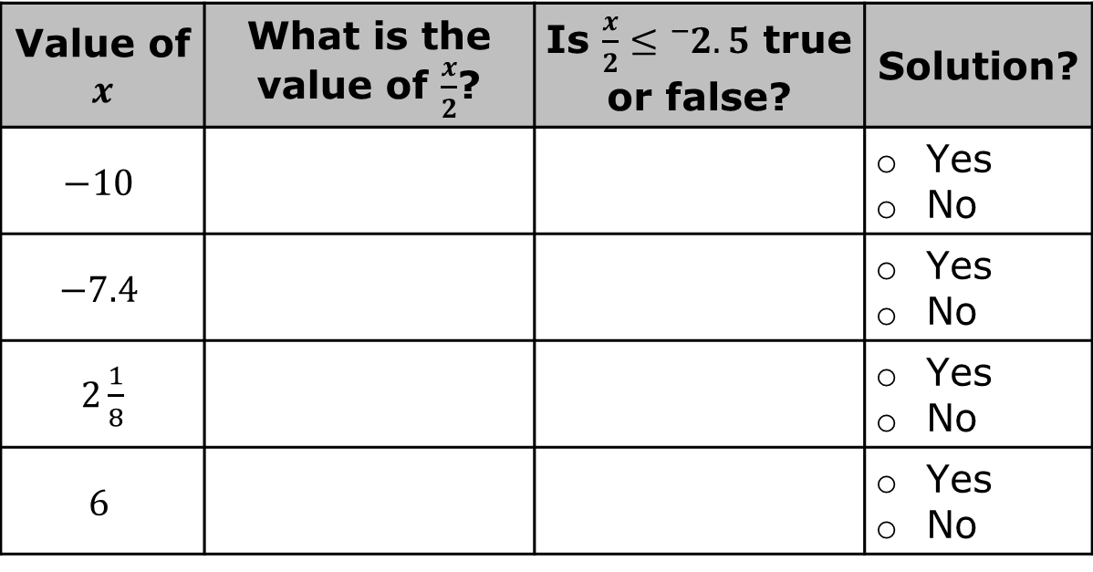
Value of $x$ | What is the value of $\frac{x}{2}$? | Is $\frac{x}{2}≤{}_{}^{−}{2.5}$ true or false? | Solution?
$$−10$$ |  |  | Yes No
$$−7.4$$ |  |  | Yes No
$2\frac{1}{8}$ |  |  | Yes No
$$6$$ |  |  | Yes No
volume 2, pg. 102

Slide 23
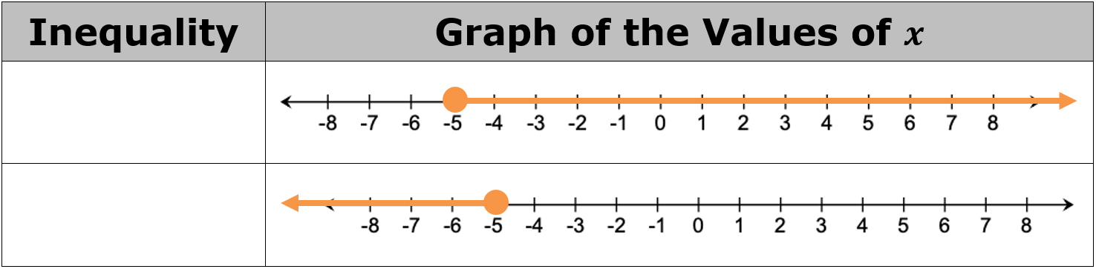
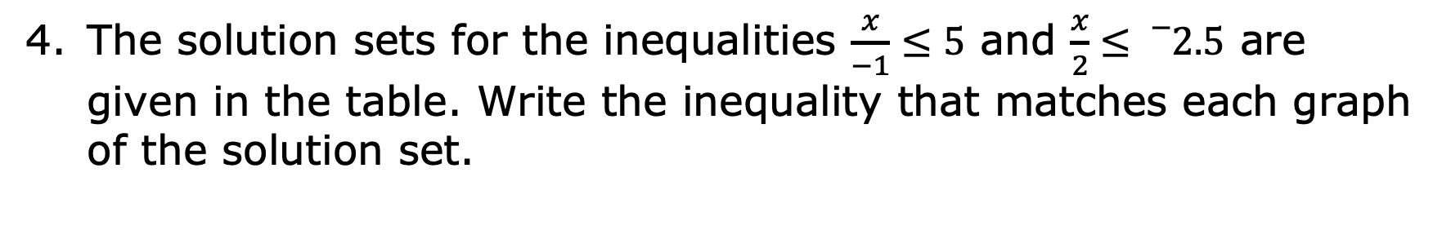
The solution sets for the inequalities $\frac{x}{−1}≤5$ and $\frac{x}{2}≤{}_{}^{−}{2.5}$ are given in the table. Write the inequality that matches each graph of the solution set.
volume 2, pg. 102

Slide 24
Look back at your answers to questions 2 and 4. What do you notice about the original inequality symbol and the direction of the arrows on the graphs of the solution sets?
Compare your work on questions 1-5 with your partner. Discuss any differences and revise your work if necessary.
volume 2, pg. 102

Slide 25
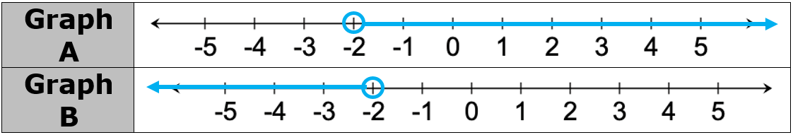
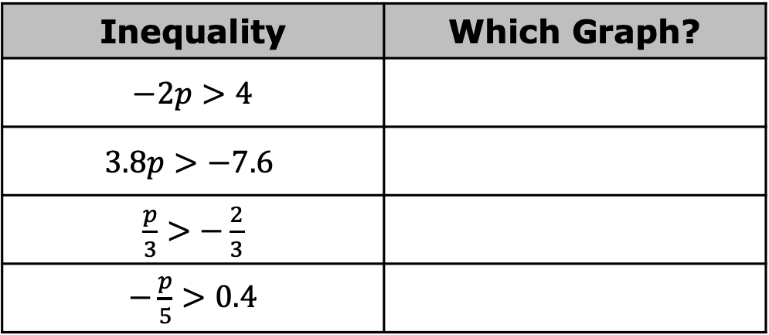
The graphs of two solution sets are shown.
The solution set for each inequality in the table matches one of the graphs. Based on your work and observations thus far, work with your partner to determine which graph matches each inequality.
Inequality | Which Graph?
$−2p>4$
$$3.8p>−7.6$$
$\frac{p}{3}>−\frac{2}{3}$
$−\frac{p}{5}>0.4$
volume 2, pg. 103

Slide 26
Explain how you and your partner determined which graphs match each inequality.
volume 2, pg. 103

Slide 27

Wrap-Up
volume 2, pg. 103

Slide 28
10.3.5 Wrap-Up: Cool Down
Make a conjecture about the relationship between the inequality symbol and the sign of the coefficient of the variable term when determining the solution set for an inequality. Use examples from the lesson if they’re helpful.
volume 2, pg. 103

